Slide 1
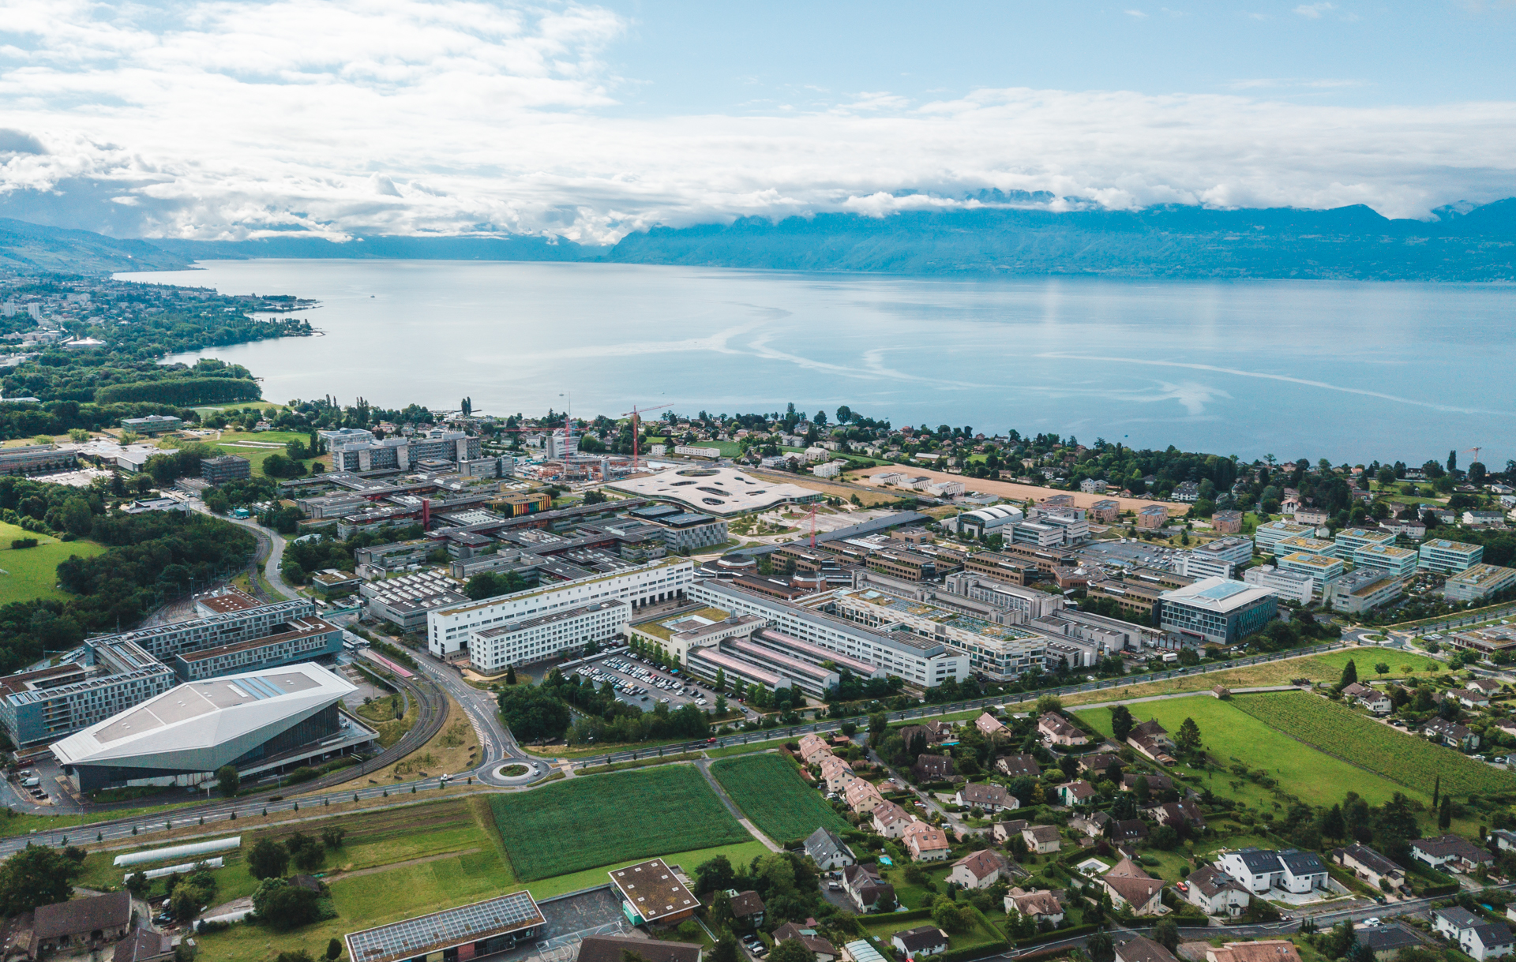
Mini-project: Audio volume control
Elias De Smijter
Erik Wilhelm Widlund Mellergård
5 june 2023

Slide 2
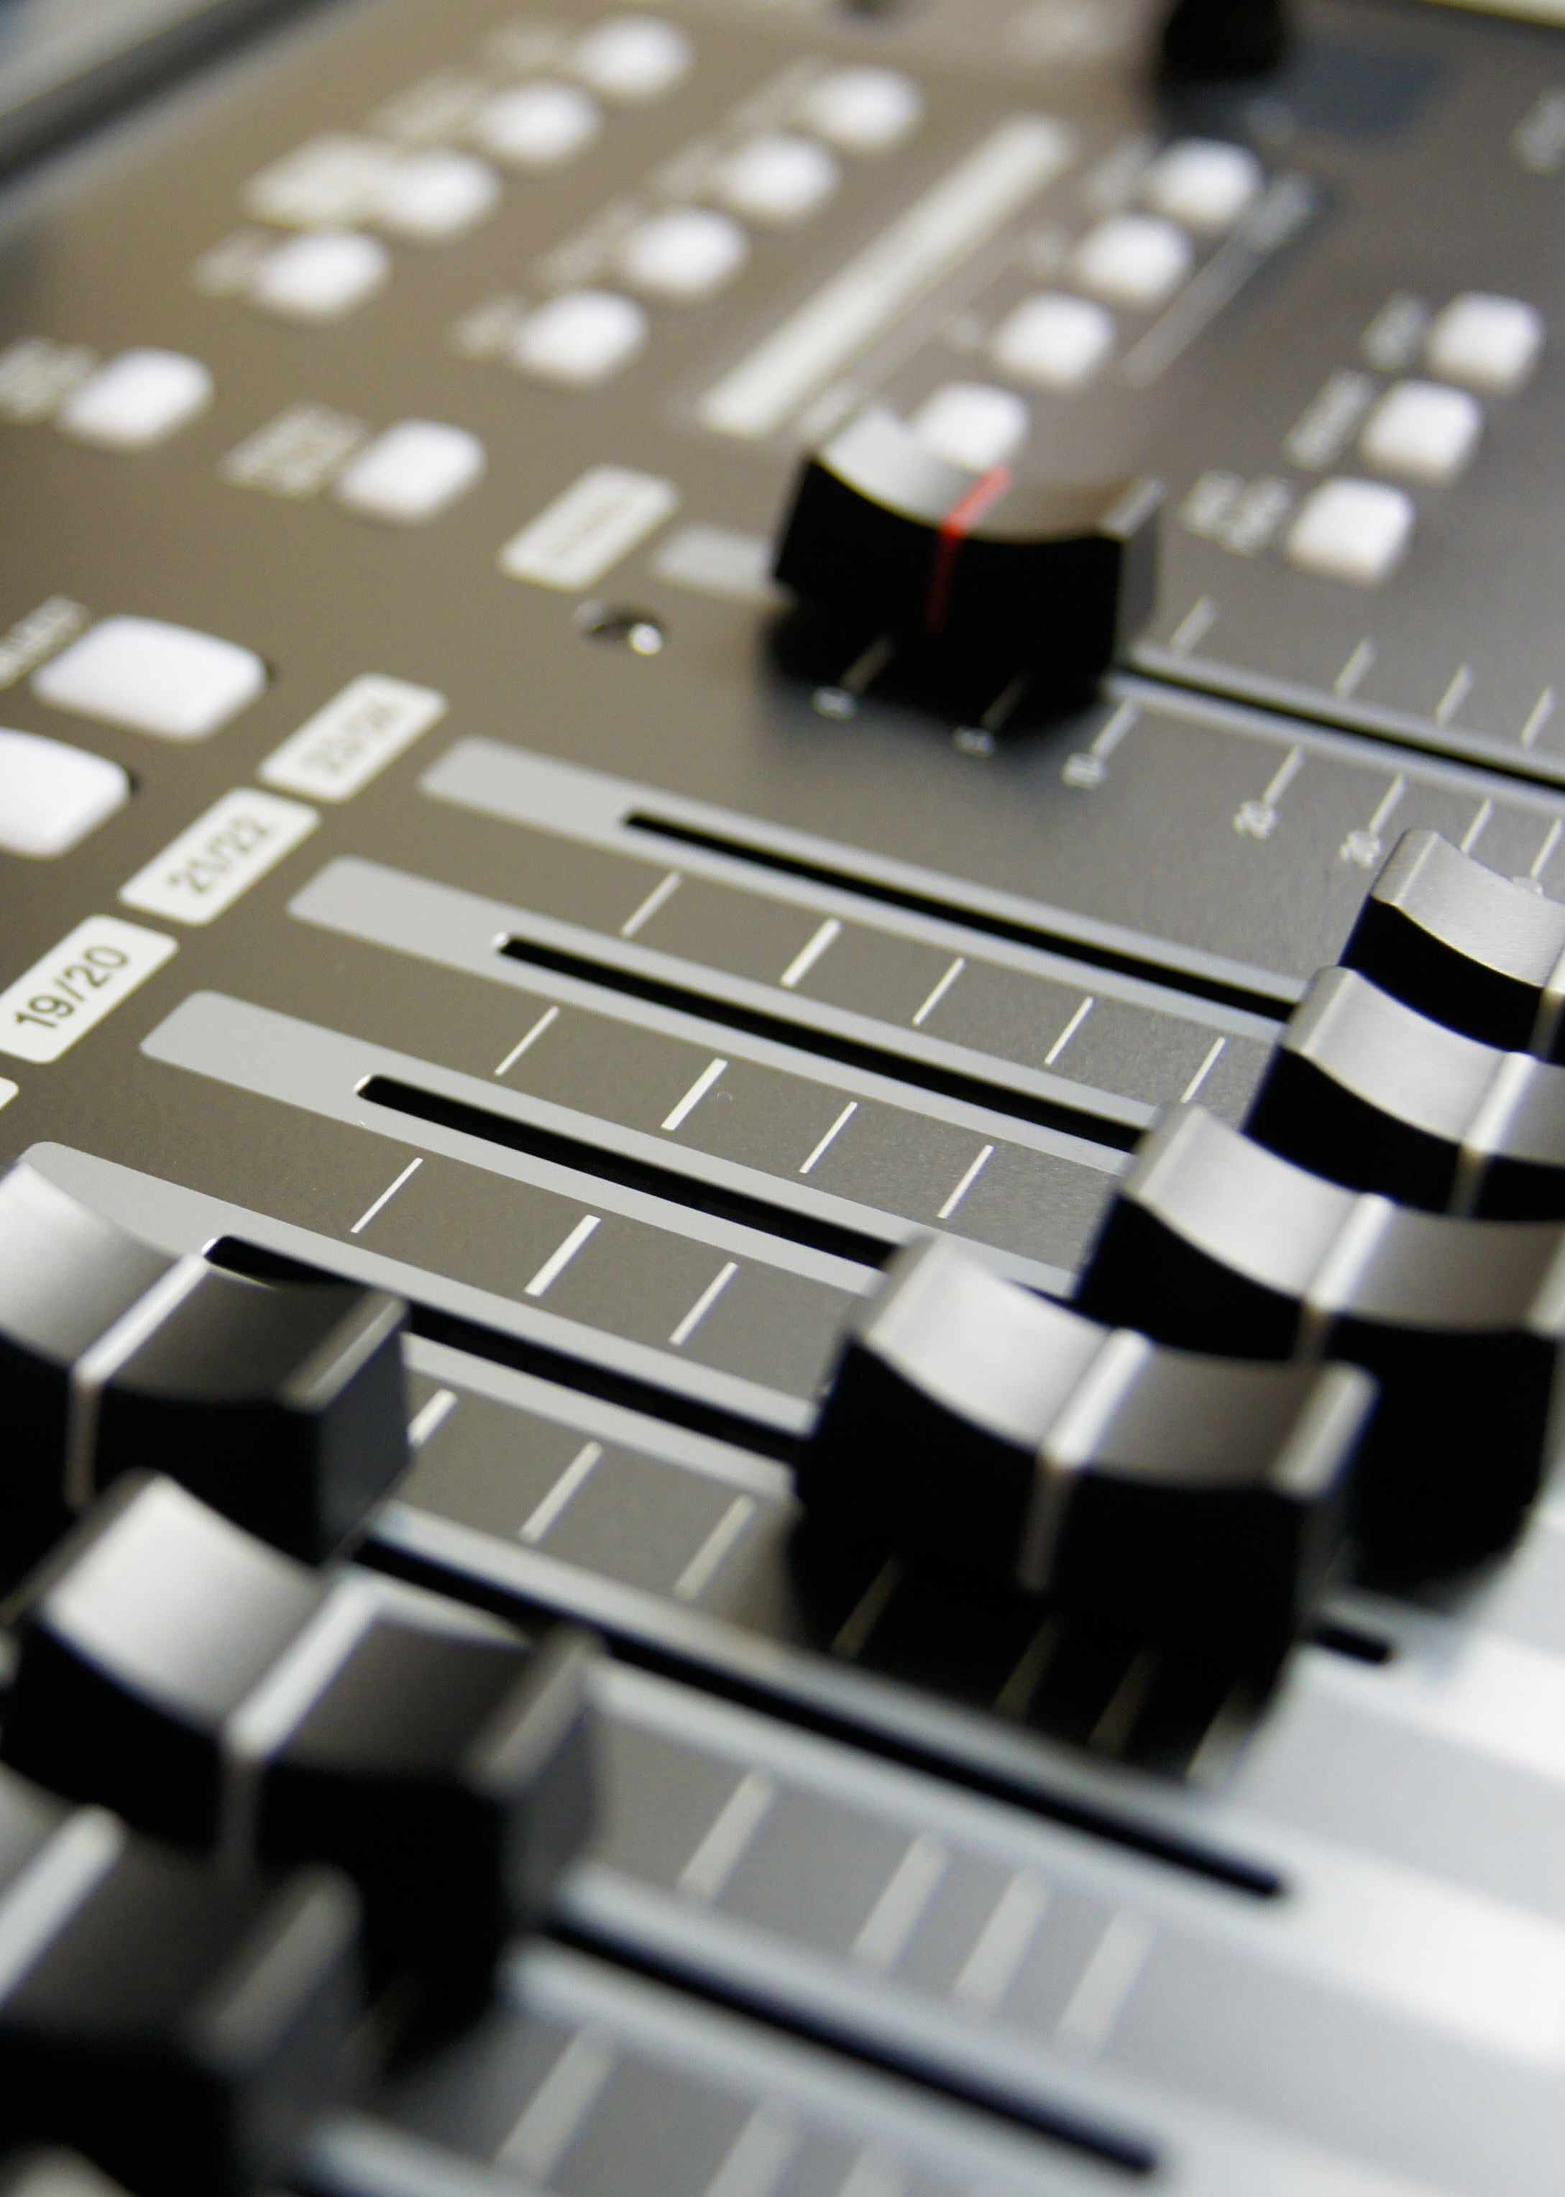
OUTLINE
Goal of the project
System description
System functioning
Profiling
Conclusion
Demo

Slide 3
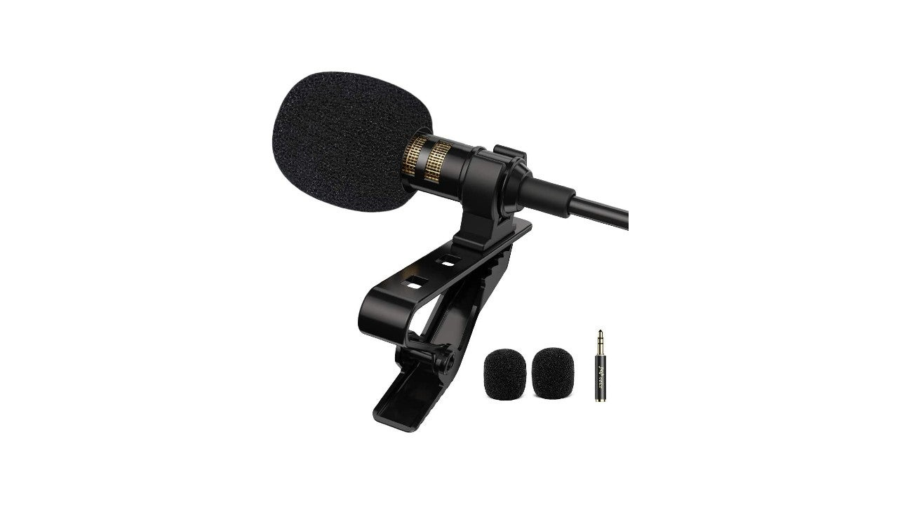
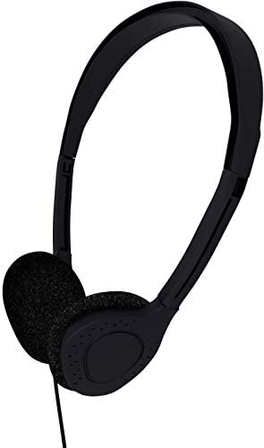
User-interface goals
Record sound
Change volume up/down
Playback sound

Slide 4
Hardware-related goals
Dual-core
Three methods
Hardware acceleration using DMA
Custom instruction
C instruction
Last two not used in practice, used for profiling

Slide 5
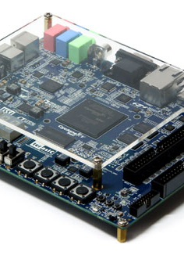
OUTLINE
Goal of the project
System description
System functioning
Profiling
Conclusion
Demo

Slide 6
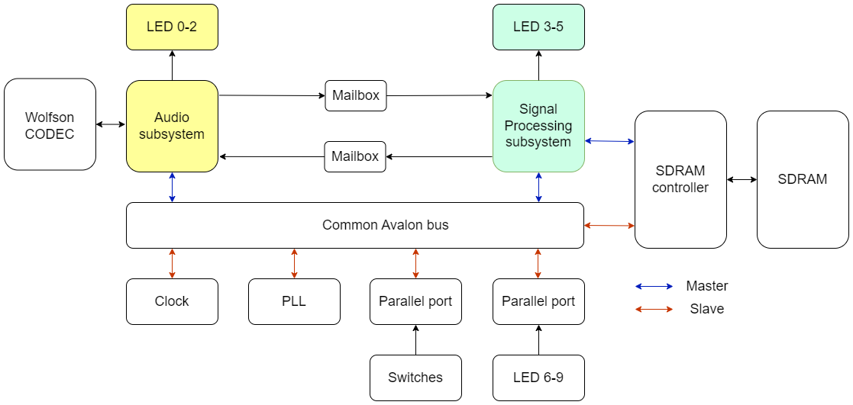
System overview
Switches: choice of task
Send interrupt to audio subsystem
Audio subsys mails SP subsys
Still shared because of parameters

Slide 7
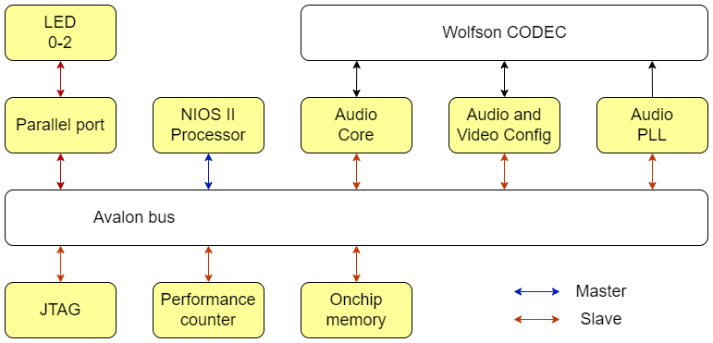
Audio subsystem
LED: early debugging
Perf counter: profiling
Onchip memory: program
JTAG: printing in terminal
Audio core
C interface
2 FIFO pairs
Config: setup
Fs: 48 kHz
ADC & DAC (32 bit digital)
PLL: clock for CODEC
12.288 MHz

Slide 8
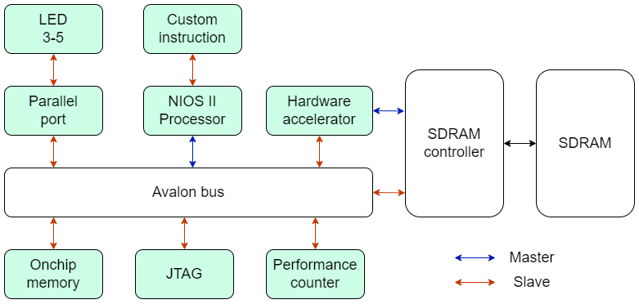
Signal processing subsystem
LED: early debugging
Perf counter: profiling
Onchip memory: program
JTAG: printing in terminal

Slide 9
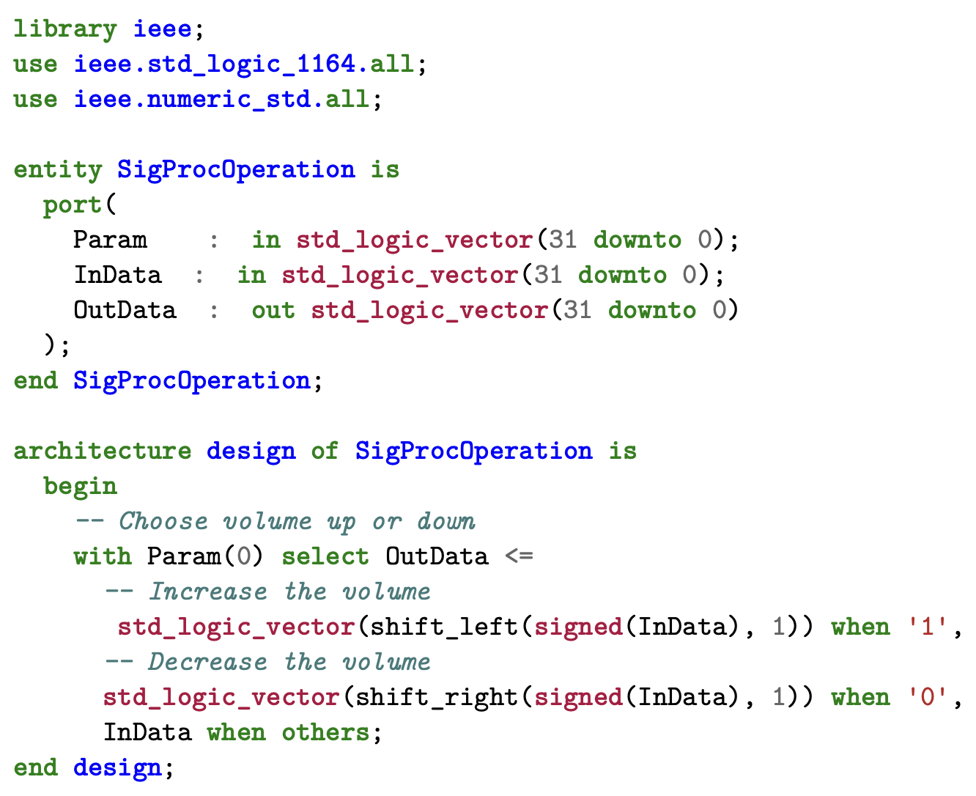
Custom instruction
Changing volume = shifting data left/right
Loading & storing of data in C: still slow!

Slide 10
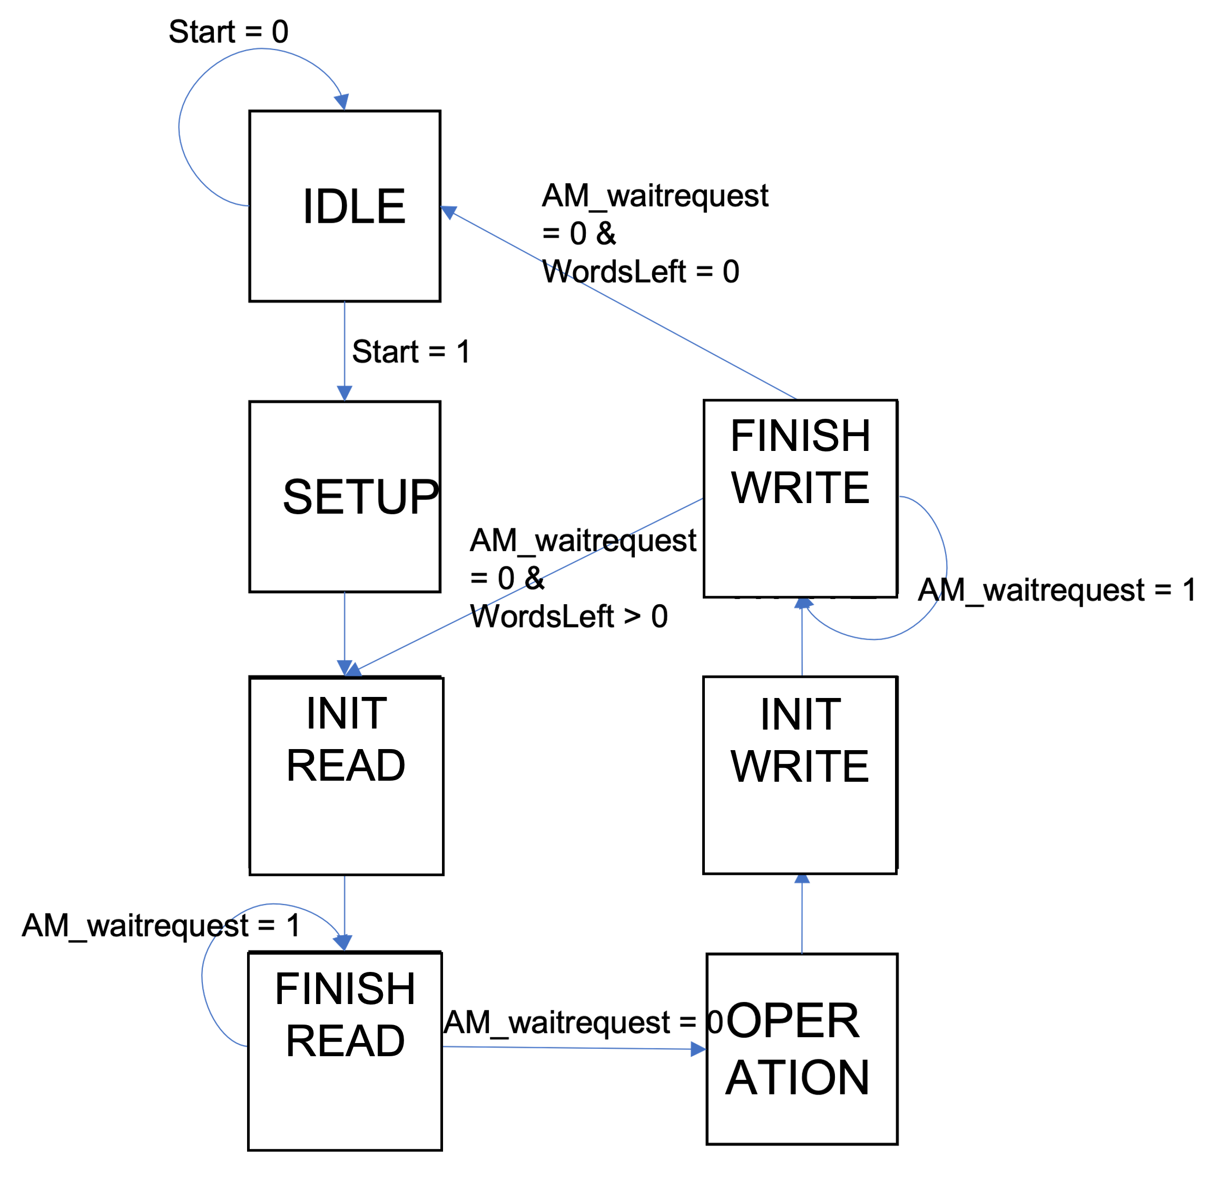
Hardware accelerator
Main goal: freeing up processor
DMA encapsulated in FSM

Slide 11
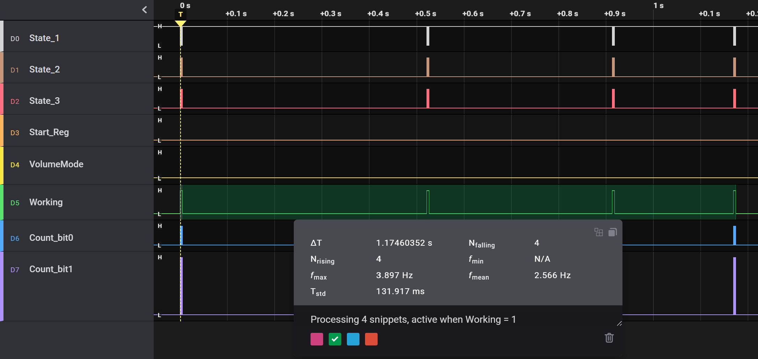
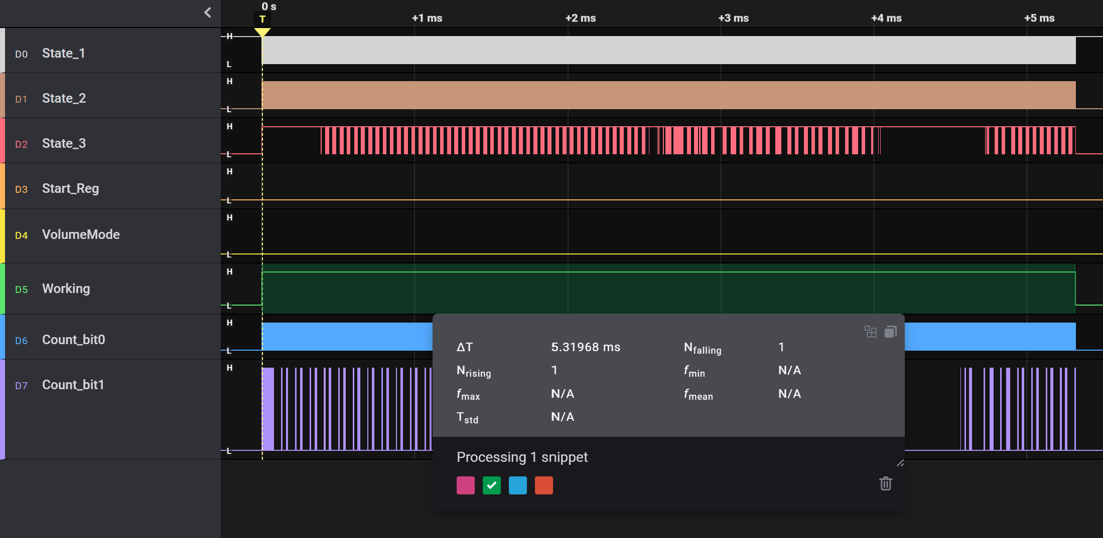
Hardware accelerator debugging functionality

Slide 12
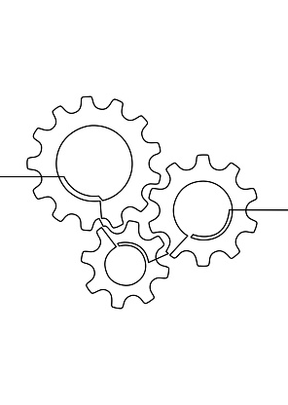
OUTLINE
Goal of the project
System description
System functioning
Profiling
Conclusion
Demo

Slide 13
Switches
SW0: record
SW1: play
SW7: volume up/down
SW2: profiling
SW3: verifying
SW4: audio device status
SW5: reset audio core
SW6: reset audio config
Recording & playback
Debugging/troubleshooting & measuring

Slide 14
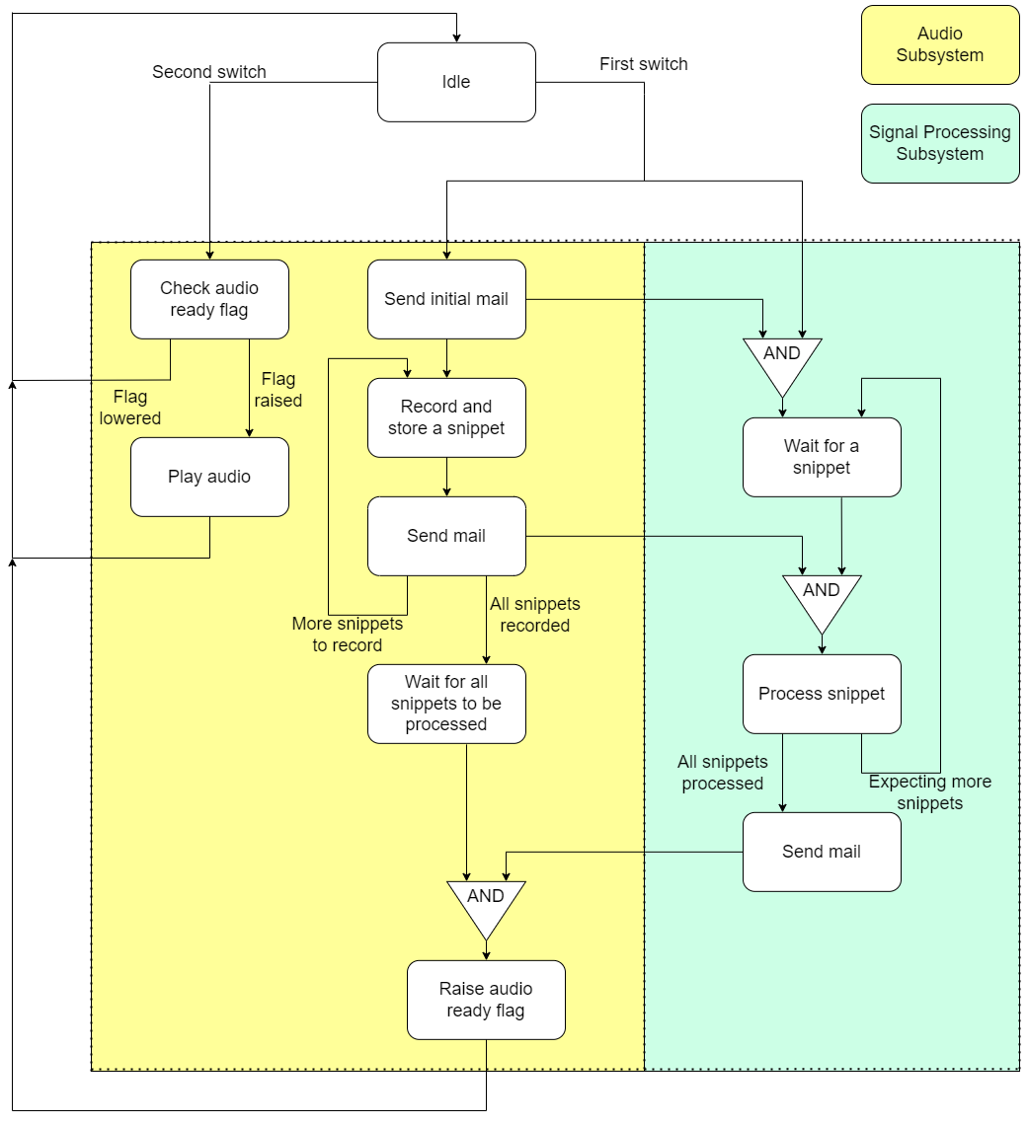
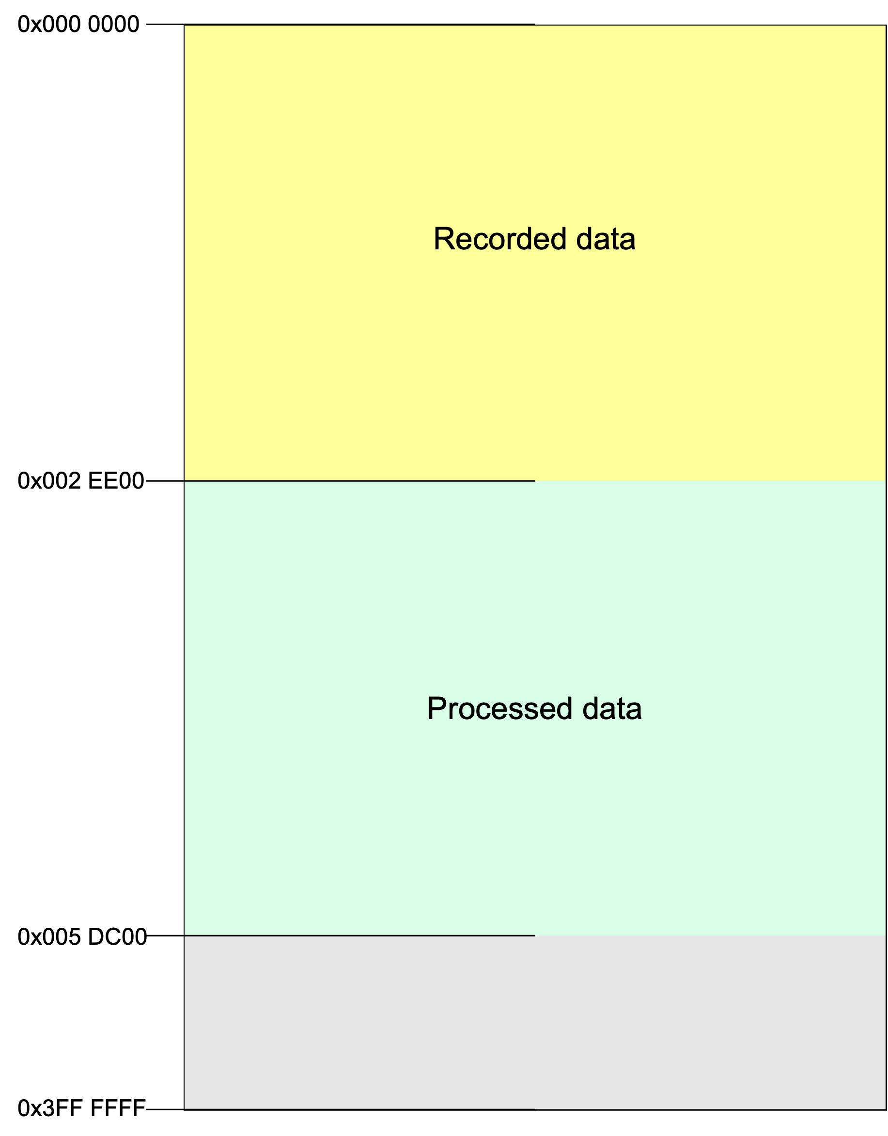
Recording & playback workflow
Only communication between subsystems by mail
Audio divided into 12 000 sample snippets (0.25 seconds)
Initial mail: what to expect (starting address of recording, amount of snippets)
Every snippet: mail

Slide 15
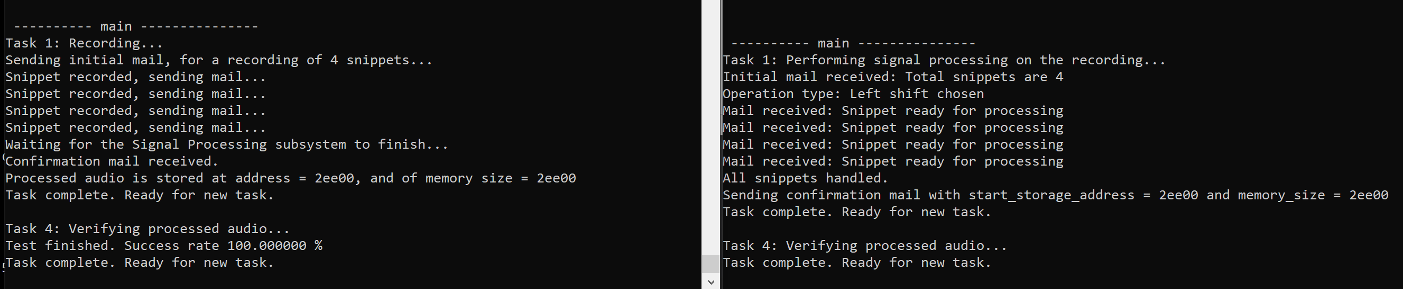
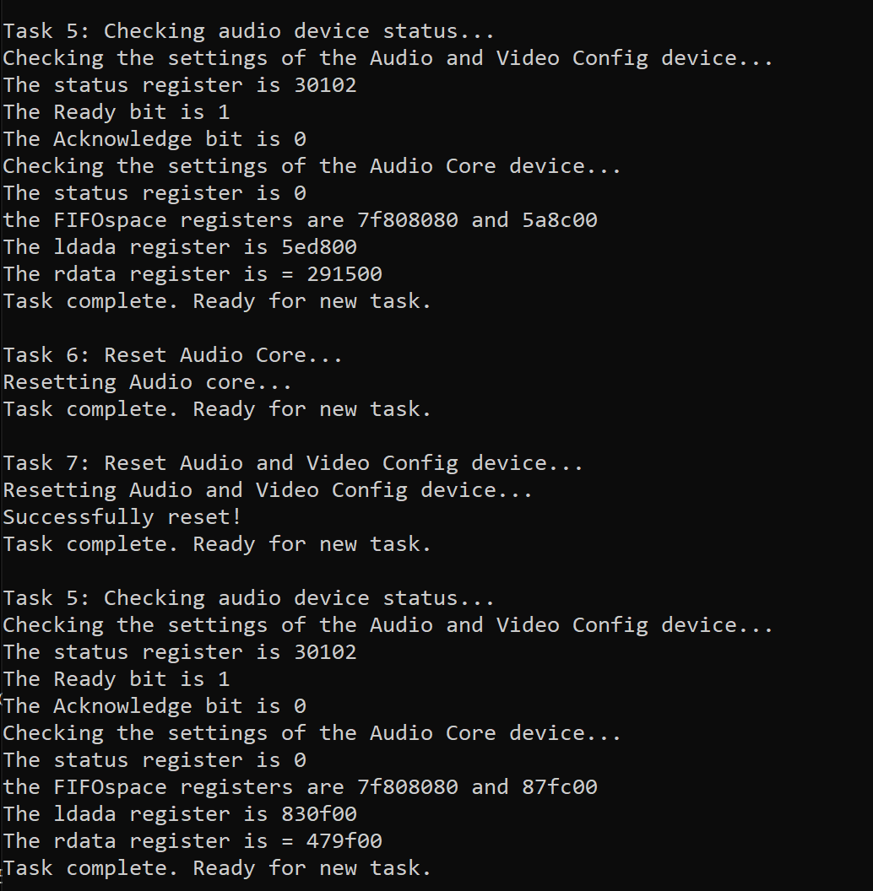
Debugging/troubleshooting & verifying workflow
Right: verification
Left: Debugging
Only ldata & rdata change!

Slide 16

OUTLINE
Goal of the project
System description
System functioning
Profiling
Conclusion
Demo

Slide 17
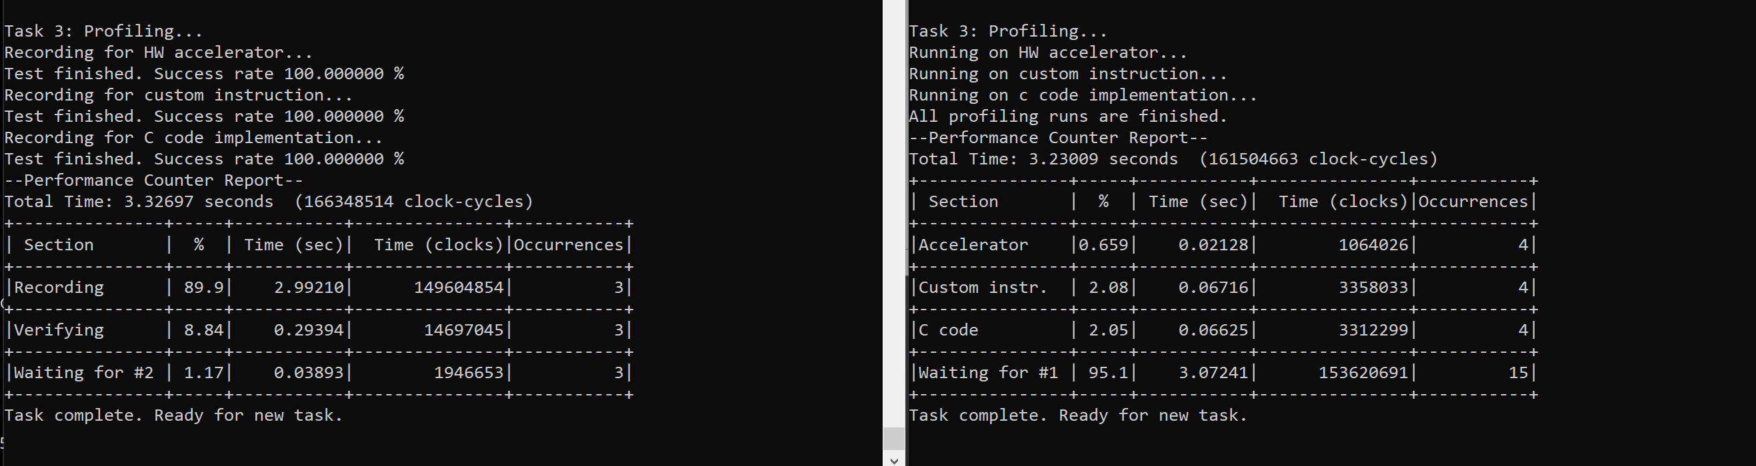
3x 1s recording, waiting and verifying
Verification: load from memory + instruction in C = slow
Waiting for #2 = f(snippet size)
Waiting: 95%
Accelerator: 3x faster (DMA)
Custom instruction as fast as C code

Slide 18
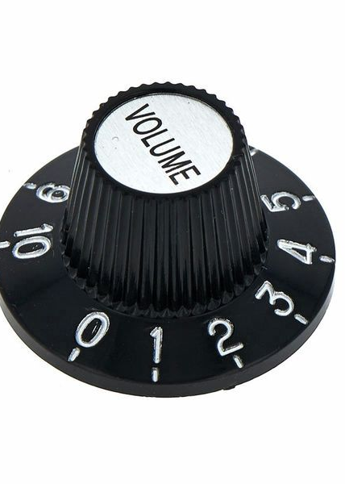
OUTLINE
Goal of the project
System description
System functioning
Profiling
Conclusion
Demo

Slide 19
Functionality implemented using dual core system
Already start processing while recording for speed up
Hardware accelerator for even more speed up

Slide 20
OUTLINE
Goal of the project
System description
System functioning
Profiling
Conclusion
Demo

Slide 21
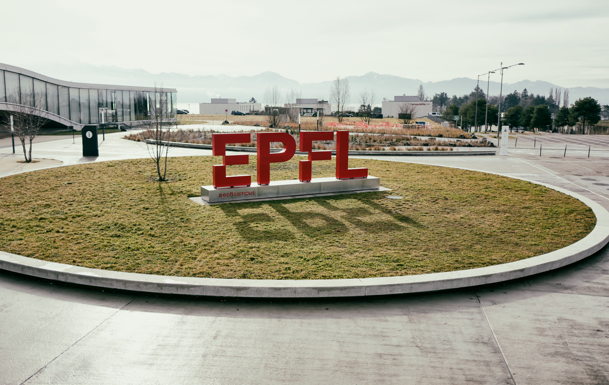
Thank you
Elias De Smijter
Erik Wilhelm Widlund Mellergård

